Slide 1

Design and Development of an Educational AI Game
Academic Year: 2025 / 2026
By Ranym Moussa
Defended on 18/07/2026 before the jury:
President : Mme Emna Hkiri
Examiner : Dr. Mohamed Amine Omrani
Supervisor : Mr. Mohamed Manaa
Industrial Supervisor : Mr. Yassine Aloui
Private Higher Polytechnic School of Monastir

Slide 2
Plan
01
General Context
06
System Design
02
Problem Statement
07
System & AI Architecture
03
Proposed Solution
08
Implementation
04
Requirements Specification
09
Voice Command Recognition
05
Methodology
10
Conclusion & Perspectives

Slide 3
01
General Context

Slide 4


1.1 Host Company
Tunisian startup named Horizon Education
Founded in 2020
In Sousse, Tunisia,
specializing in the development of Educational Games
Main Product : Mobile App called Ferid around the world
1

Slide 5
1.2 Why Teach AI to Children?
AI already shapes healthcare, transport, communication, education
Yet nearly all AI-education material assumes prior programming or math knowledge
Gap: no accessible way for a 6 - 12 year old to grasp how a machine actually learns
Serious games + implicit learning = a way to teach the workflow of AI without teaching code
2

Slide 6
1.3 Existing Solutions & Their Limits
Solution | What it teaches | Limit
Machine Learning for Kids | Build simple ML models via visual programming | Needs prior coding knowledge, older kids
Code.org , AI for Oceans | Classification via an ocean-cleanup game | Covers one AI technique only
Google Quick, Draw! | Image recognition demo | Doesn't teach the Ai pipeline
None of them show the complete journey from raw data to an autonomous decision
3

Slide 7
02
Problem Statement

Slide 8
Problem Statement
No age-appropriate path through the full AI pipeline
Fragmented tools — one technique each, never the full workflow
Gap: data → decision never shown end-to-end
4

Slide 9
03
Proposed Solution

Slide 10
An AI Curriculum, Disguised as a Game
AI Learning Journey — 7 mini-games, ages 5–10
Each game = one real AI stage, made playable
World map: complete → unlock → progress
No code, no math — just the workflow:
collect → clean → recognize → validate → debug → plan → decide
5

Slide 11
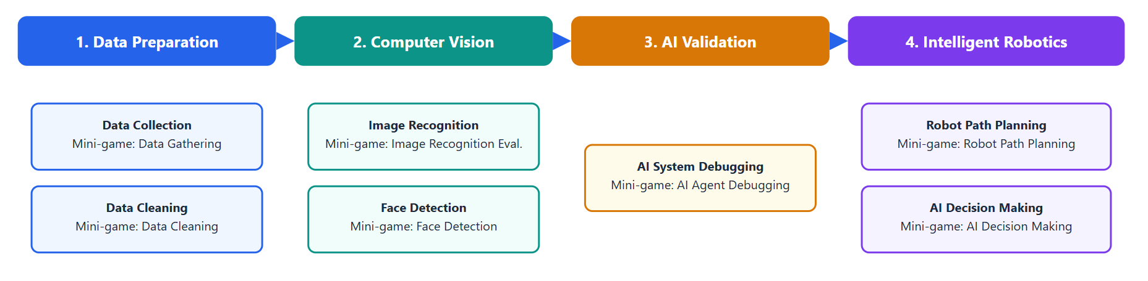
The AI Pipeline the Child Walks Through
6

Slide 12
04
Requirements Specification

Slide 13
Requirements
Functional
Display a world map with progressive unlocking
Interactive tutorial in the main games
Evaluate the player's actions with immediate feedback
Save progress, resume across sessions
Non Functional
Usability for ages 6 - 12 · Performance
Reliability · Maintainability (modular)
Scalability · Compatibility (Android/Unity)
Accessibility (visual + audio guidance)
7

Slide 14
05
Methodology

Slide 15
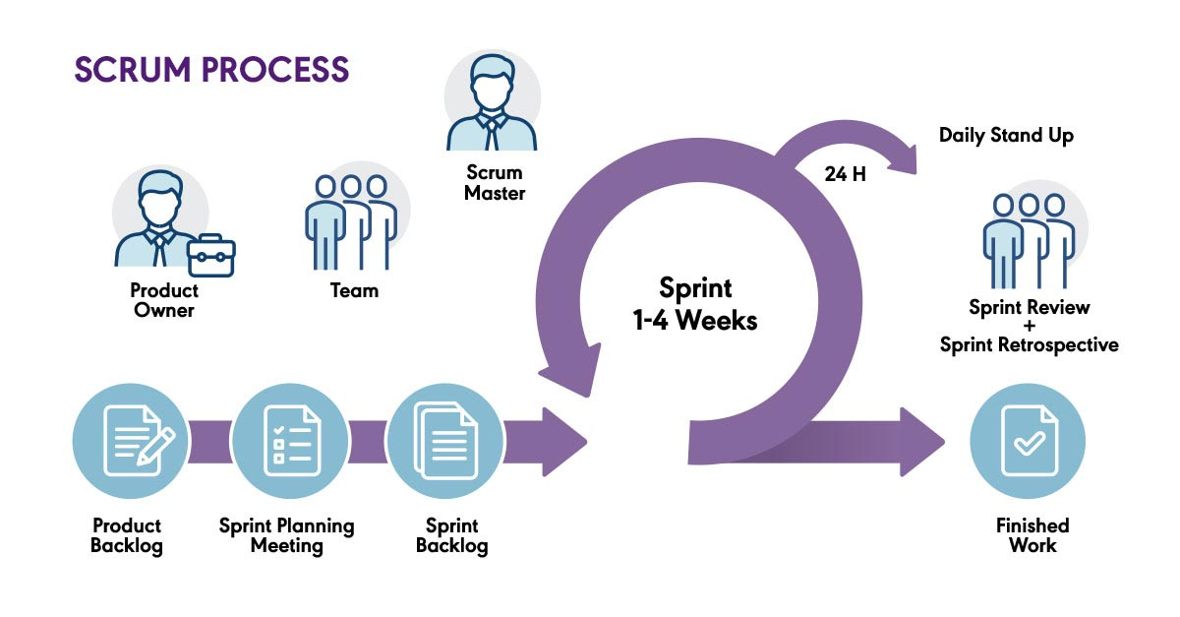
Agile Scrum
8

Slide 16
06
System Design

Slide 17
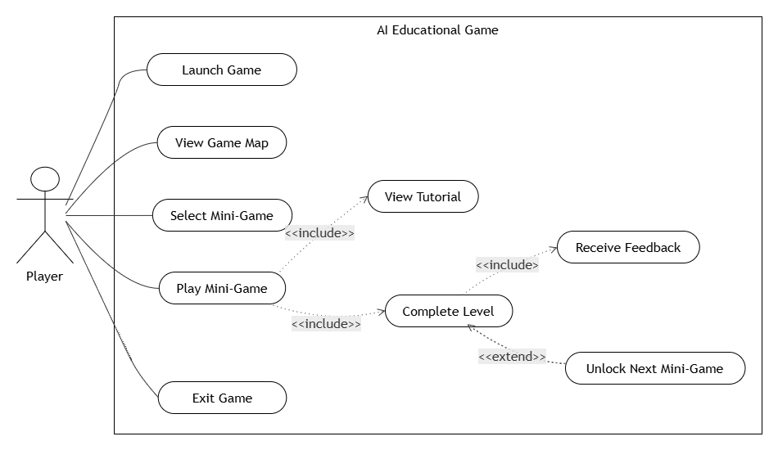
General Use Case Diagram
9

Slide 18
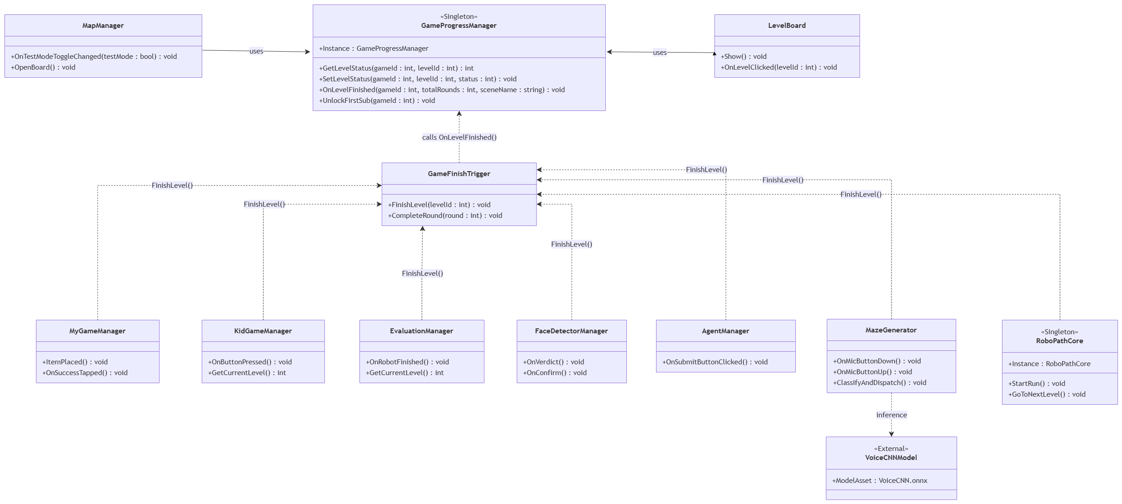
General Class Diagram
10

Slide 19
07
System & AI Architecture

Slide 20
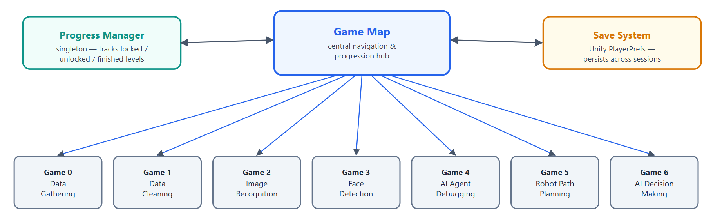
Overall System Architecture
11

Slide 21






Technology Stack
Game development Framework
Programming Language
training the voice-recognition CNN
graphical assets
running that trained model offline, inside the game
version control
12

Slide 22
08
7 Mini Games
7 AI Concepts

Slide 23
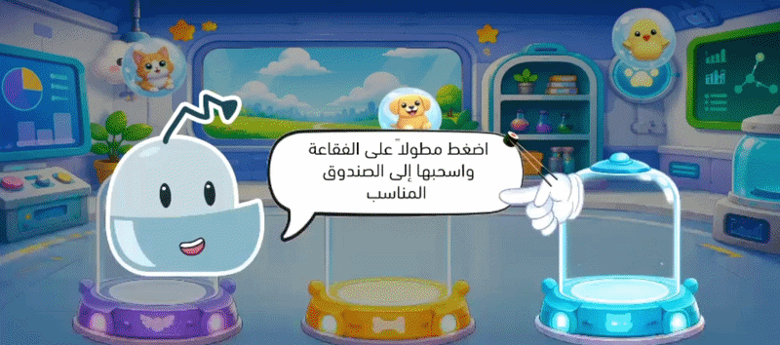
Data Gathering
Gameplay
Drag animals into their correct categories.
The real AI concept
Every AI system starts with data, a model is only as good as the data it's trained on ("garbage in, garbage out") Sorting animals is the data-collection step of a real ML pipeline, made physical
13

Slide 24
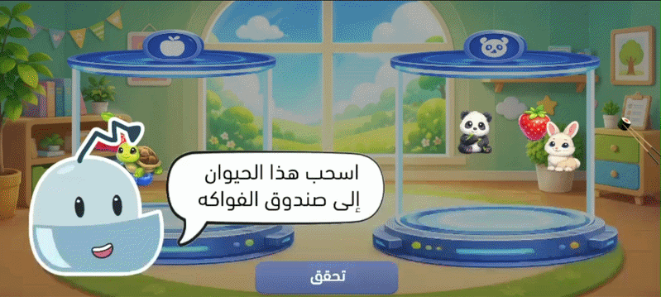
Data Cleaning
Gameplay
Sort objects across levels of increasing difficulty, the game deliberately starts with some items mis sorted.
The real AI concept
Raw collected data is noisy and partly mislabeled, it must be reviewed and cleaned before it can train a model. The deliberately wrong starting arrangement mirrors real messy datasets.
14

Slide 25
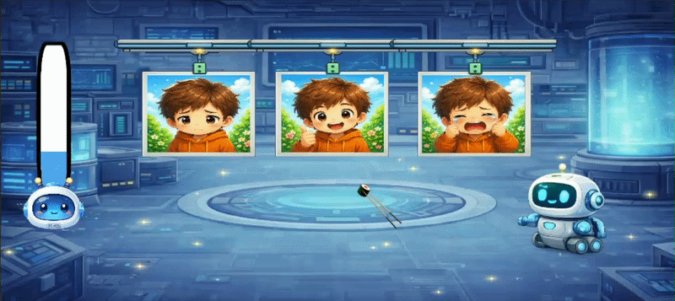
Image Recognition Evaluation
Gameplay
The robot labels images, the child judges whether each prediction is right or wrong.
The real AI concept
You never blindly trust a model's output, you evaluate its predictions against ground truth. That's literally what an ML engineer does with a validation set. The robot's simulated accuracy score visibly rises or falls based on the child's own judgement.
15

Slide 26
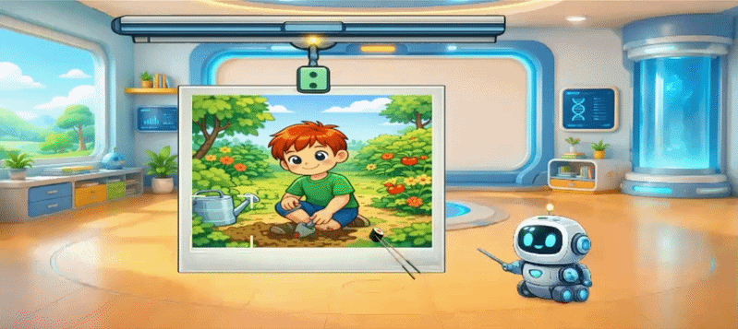
Face Detection
Gameplay
The robot draws a box around what it thinks is a face, the child confirms or drags it to the correct spot.
The real AI concept
Object localization a model must first find something in an image before it can recognize or analyze it. Correcting a wrong box mirrors human in the loop labeling, a real technique used to improve production AI systems.
16

Slide 27
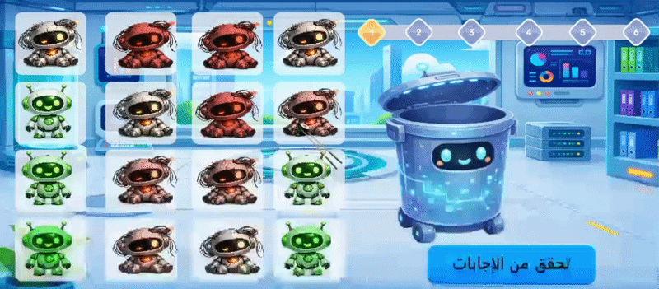
AI Agent Debugging
Gameplay
A grid of AI agents, some faulty, the child bins the faulty ones and keeps the good ones
The real AI concept
AI systems fail silently and need active auditing you can't assume a deployed model is correct. Scoring rewards catching real faults more than it penalizes false alarms (0.20 vs 0.15 weighting), mirroring how debugging prioritizes recall over caution.
17

Slide 28
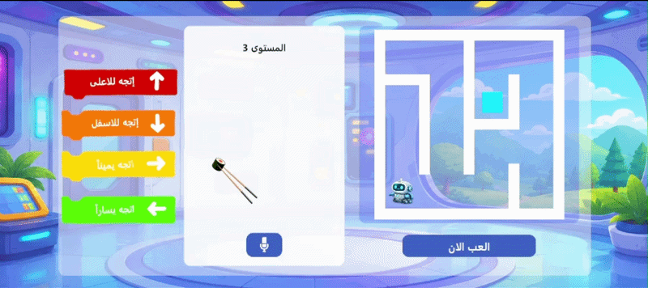
Robot Path Planning
Gameplay
Build a movement program drag blocks or speak commands to guide the robot through a maze
The real AI concept
Planning a sequence of actions to reach a goal under constraints a classic AI search planning problem. This is also where the project's real trained neural network
18

Slide 29
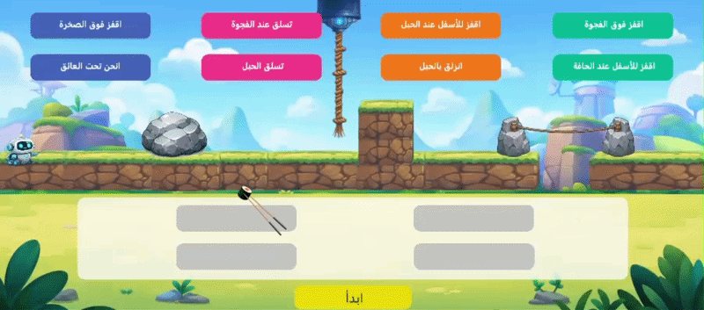
AI Decision Making
Gameplay
Place the right action card at each decision point along a fixed path.
The real AI concept
The same "path" requires different actions depending on context context-aware action selection, the same idea behind a policy function in a decision making AI system.
19

Slide 30
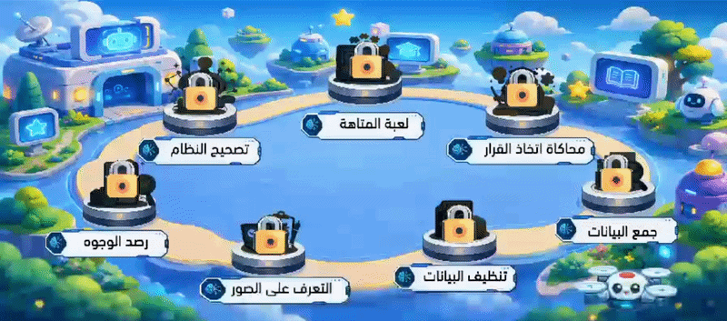
The Game Map
Central navigation: an animated drone travels a fixed path, one stop per mini-game
Finishing a game → drone flies to next stop → lock fades → progress saved
20

Slide 31
09
Voice Command Recognition

Slide 32
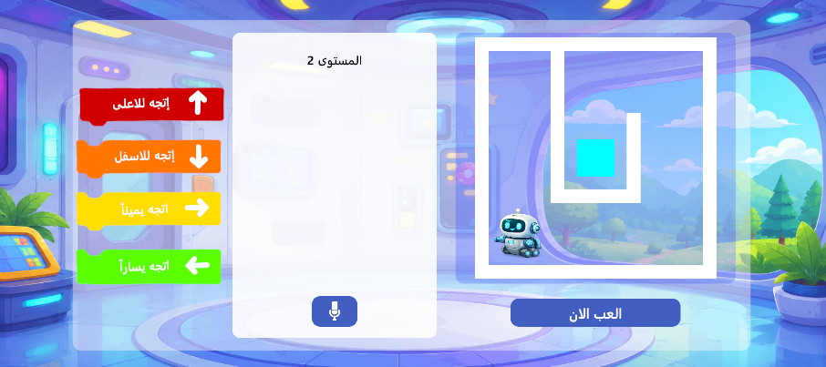
Where This Fits
Integrated into Robot Path Planning: spoken commands replace dragging blocks
21

Slide 33
Why CNN
Criterion | CNN | LSTM | Transformer
Keyword spotting | Excellent | Good | Excellent
Real-time inference | Fast | Moderate | Heavy
Small dataset | Suitable | Moderate | Large dataset needed
Computational cost | Low | Medium | High
Suitable for our project
22

Slide 34
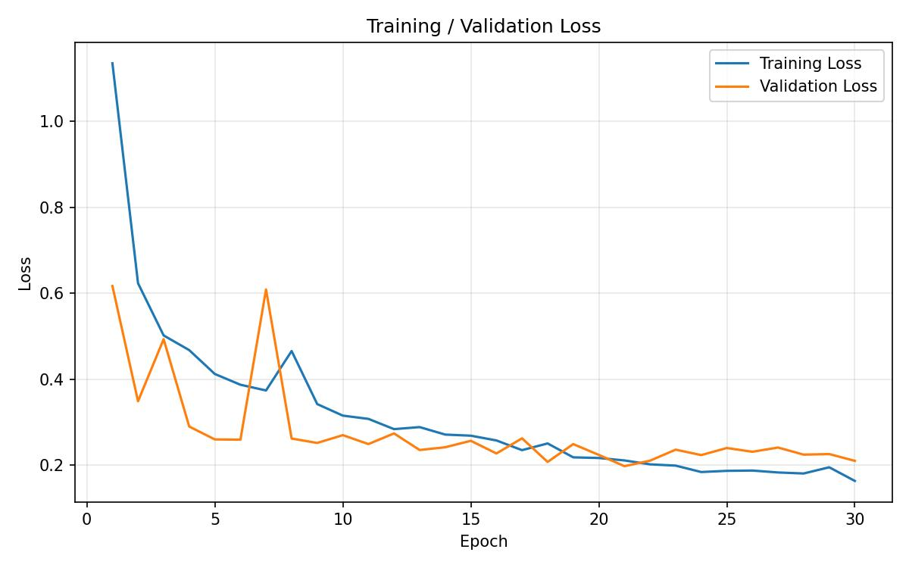
Validation Loss
23

Slide 35
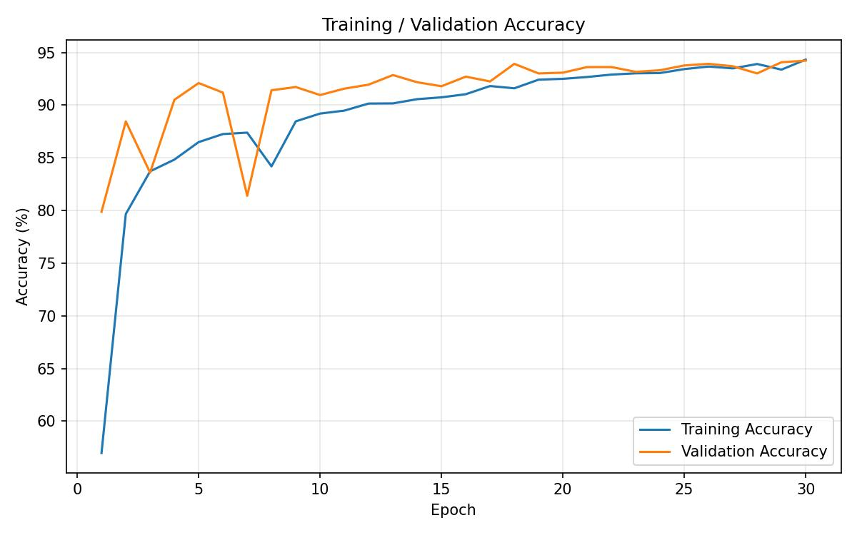
Validation Accuracy
24

Slide 36
The Task & The Data
6 class classification: up · down · left · right · unknown · silence
The unknown/silence classes let the model withhold a prediction instead of guessing on unclear audio
Dataset: Google Speech Commands v0.02 thousands of labelled single-word recordings from many speakers
25

Slide 37
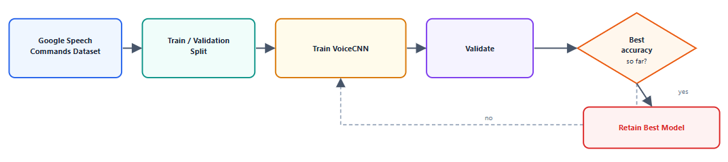
Training
26

Slide 38
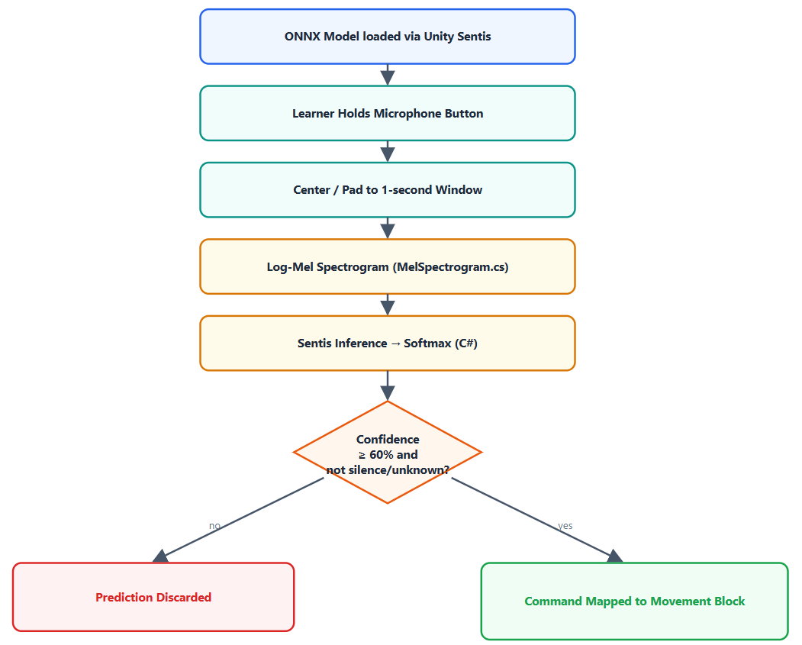
Deployment in Unity
27

Slide 39
28

Slide 40
10
Conclusion
& Perspectives

Slide 41
Conclusion
Delivered a 7 mini game platform that walks children 6 – 12 through the entire AI development pipeline not an isolated technique, the full workflow
Backed by a real, deployed AI system: a CNN based offline speech recognizer, not just a simulated one
29

Slide 42
Future Perspectives
Multilingual speech recognition Arabic, French
Larger, more diverse voice dataset; improved robustness to background noise
Additional AI concepts and mini games extending the pipeline further
30

Slide 43

Mouse and keyboard

